Slide 1
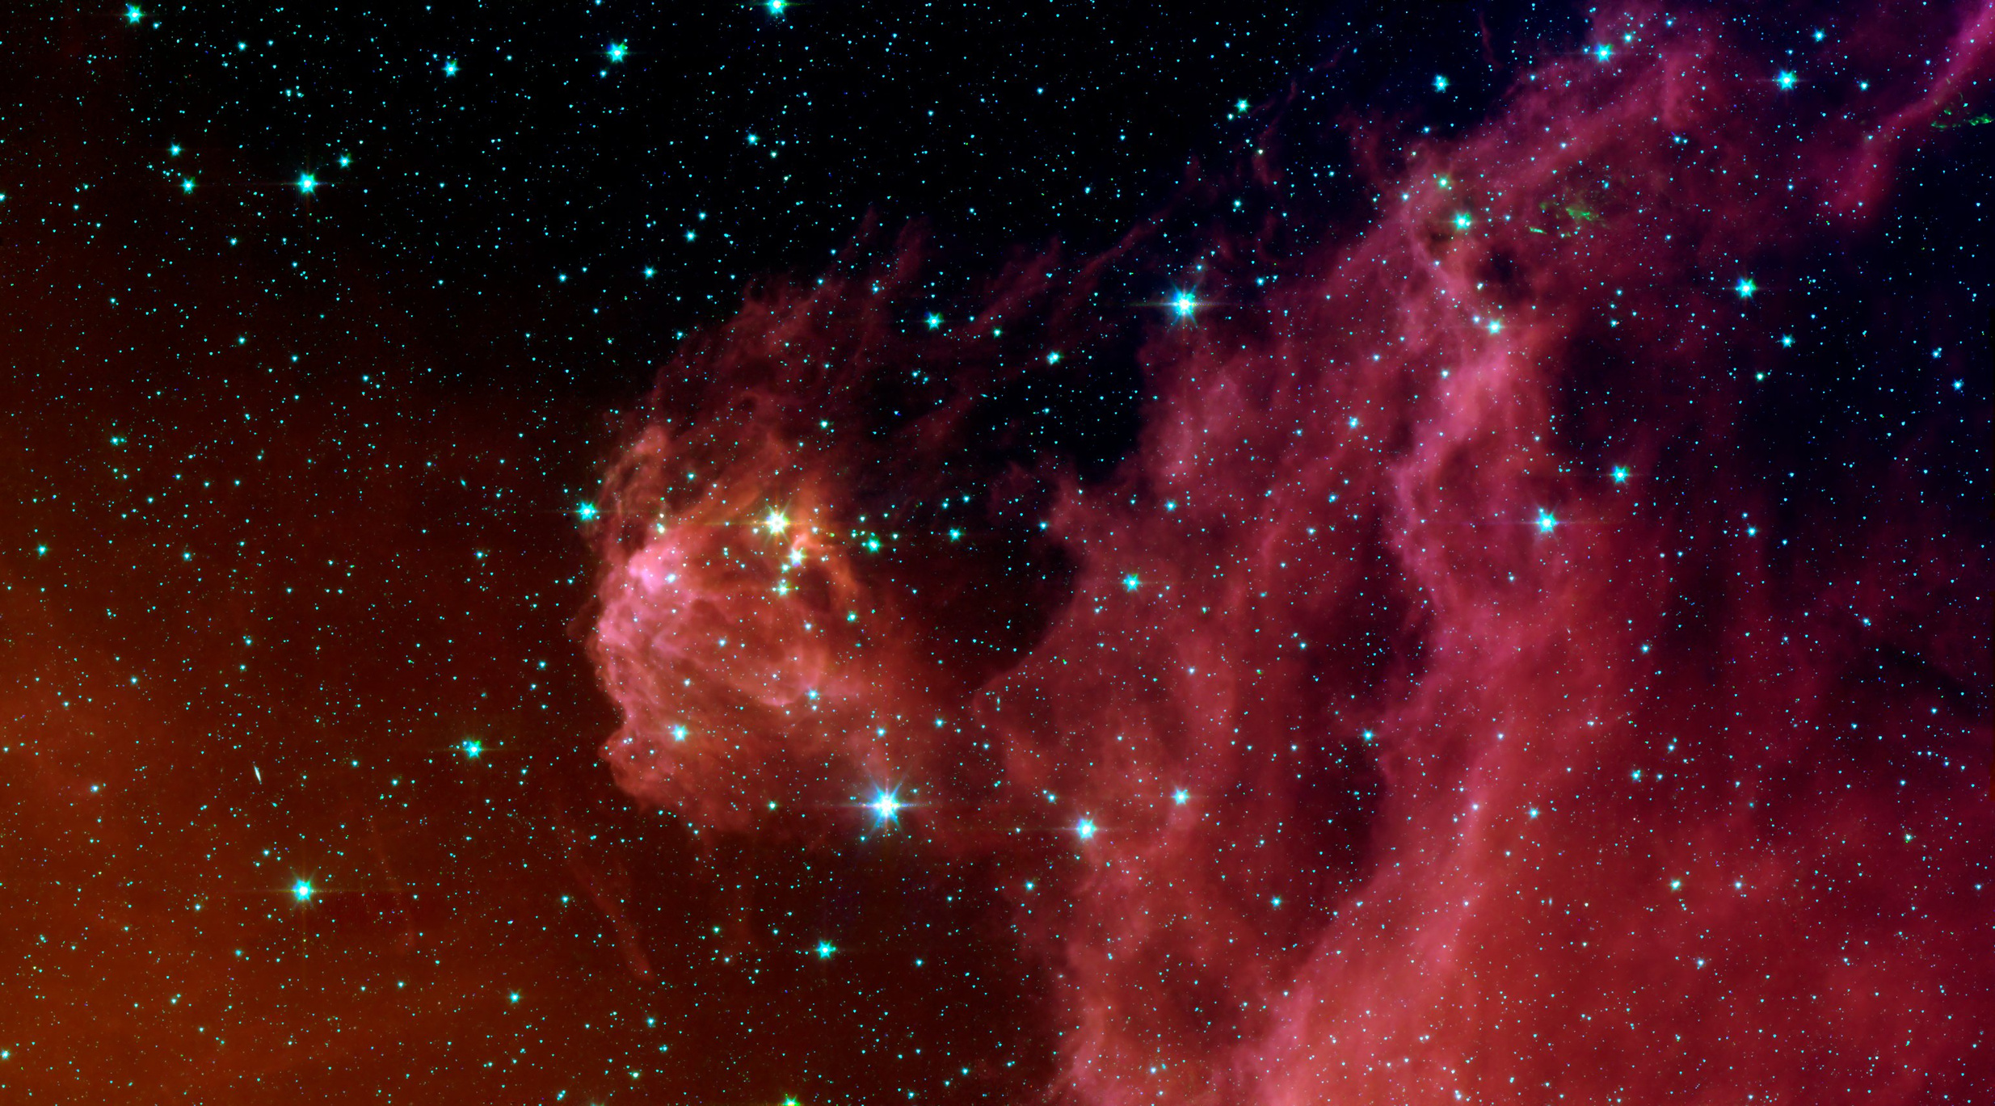

SEARCHING FOR BLUE STRAGGLERS
Author: Jacob Romeo
Professor: Dr. Istvan Szapudi
ASTR 758: Programming for Astronomers

Slide 2

what your suffering entails
Introduction
Background
Overview
Results
Final Table
Summary
Questions

Slide 3
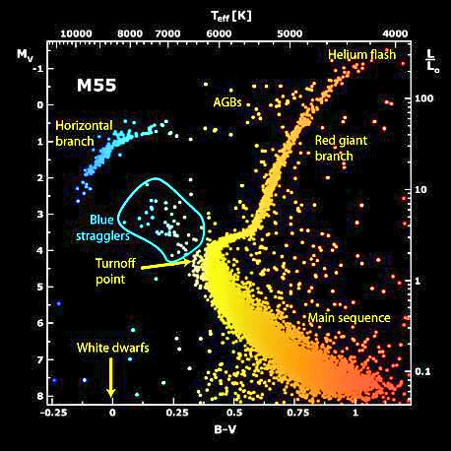
PROJECT INTRODUCTION
Blue Stragglers (BSS) exist where they are not supposed to on the HRD, appearing younger than they actually are.
01
Mergers or are currently merging with another star. Adding more fuel to the fire and becoming more blue.
02
By studying their pulsations we can understand how their internal structure works and how they were formed.
03

Slide 4
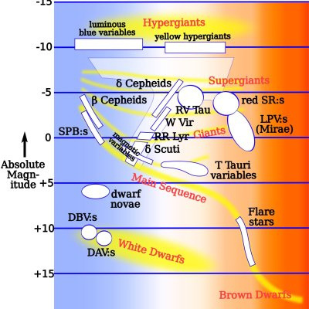
PROJECT BACKGROUND
Researched roAps during my undergraduate, made me want to begin a career in asteroseismology.
Little to no data on why BSS form and their interior structure. Studying them along with other poorly studied pulsators could answer a lot of questions.

Slide 5
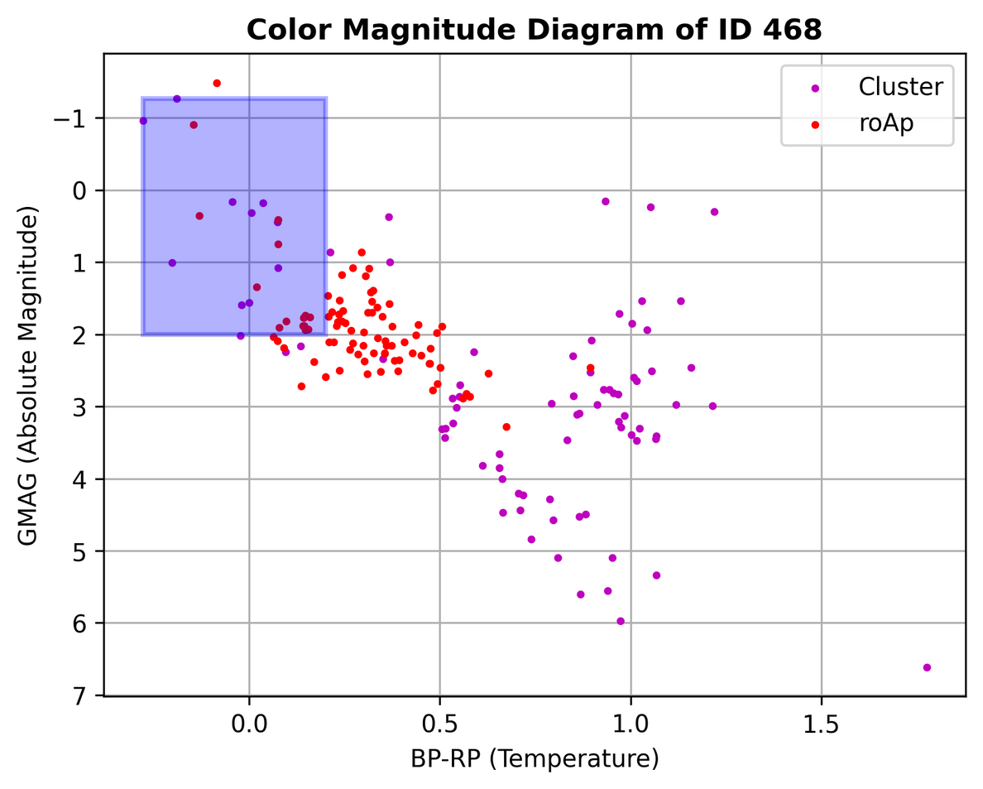
PROJECT
OVERVIEW
Getting cluster and cluster members data from the “J/A+A/686/A42" catalog using Vizier. Cross-Referencing data with Starhorse.
01
Plotting the de-reddened data and selecting the region where BSS fall into on the CMD. Using roAp stars as a reference for selecting the region.
02
Taking the candidates and using the “lightkurve” package to search for short cadence data in TESS.
03

Slide 6
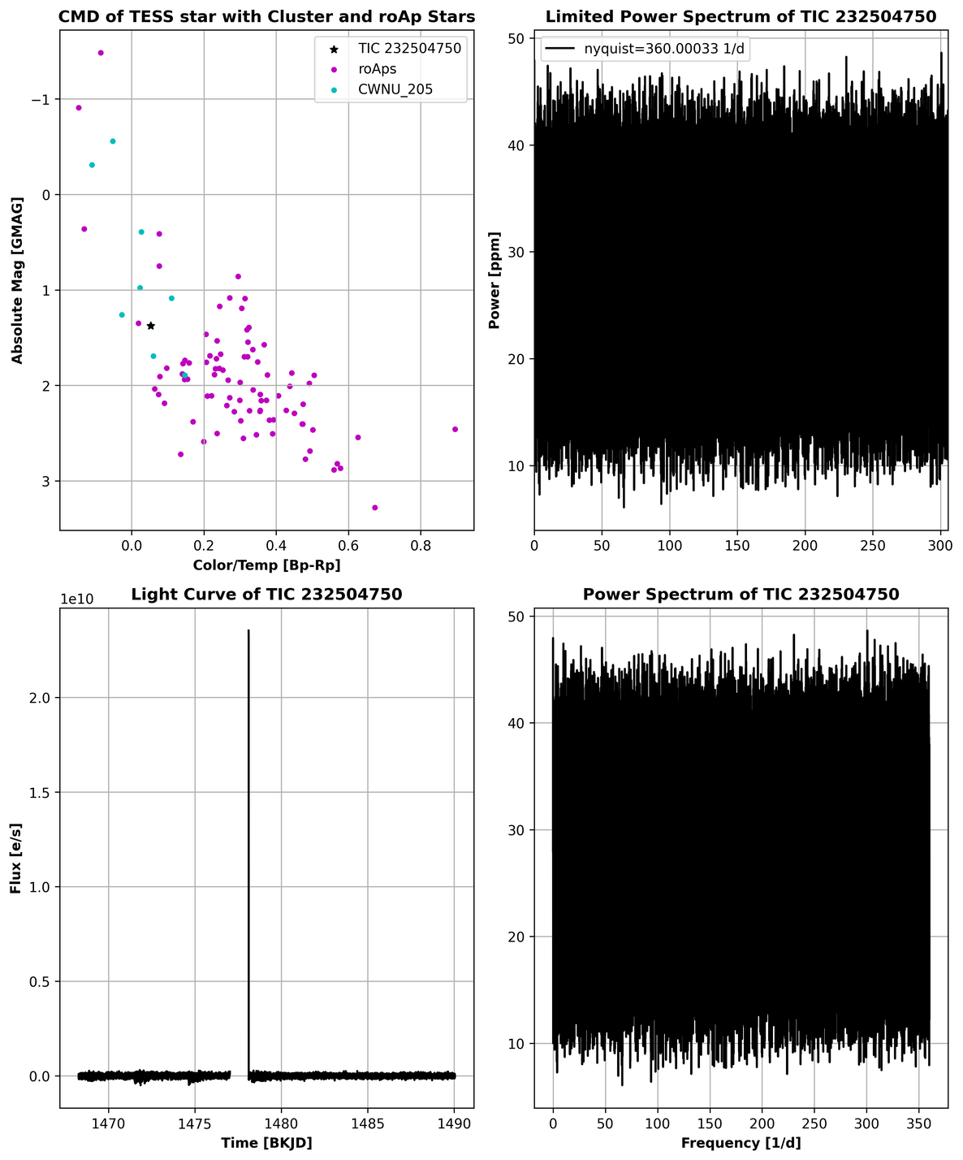
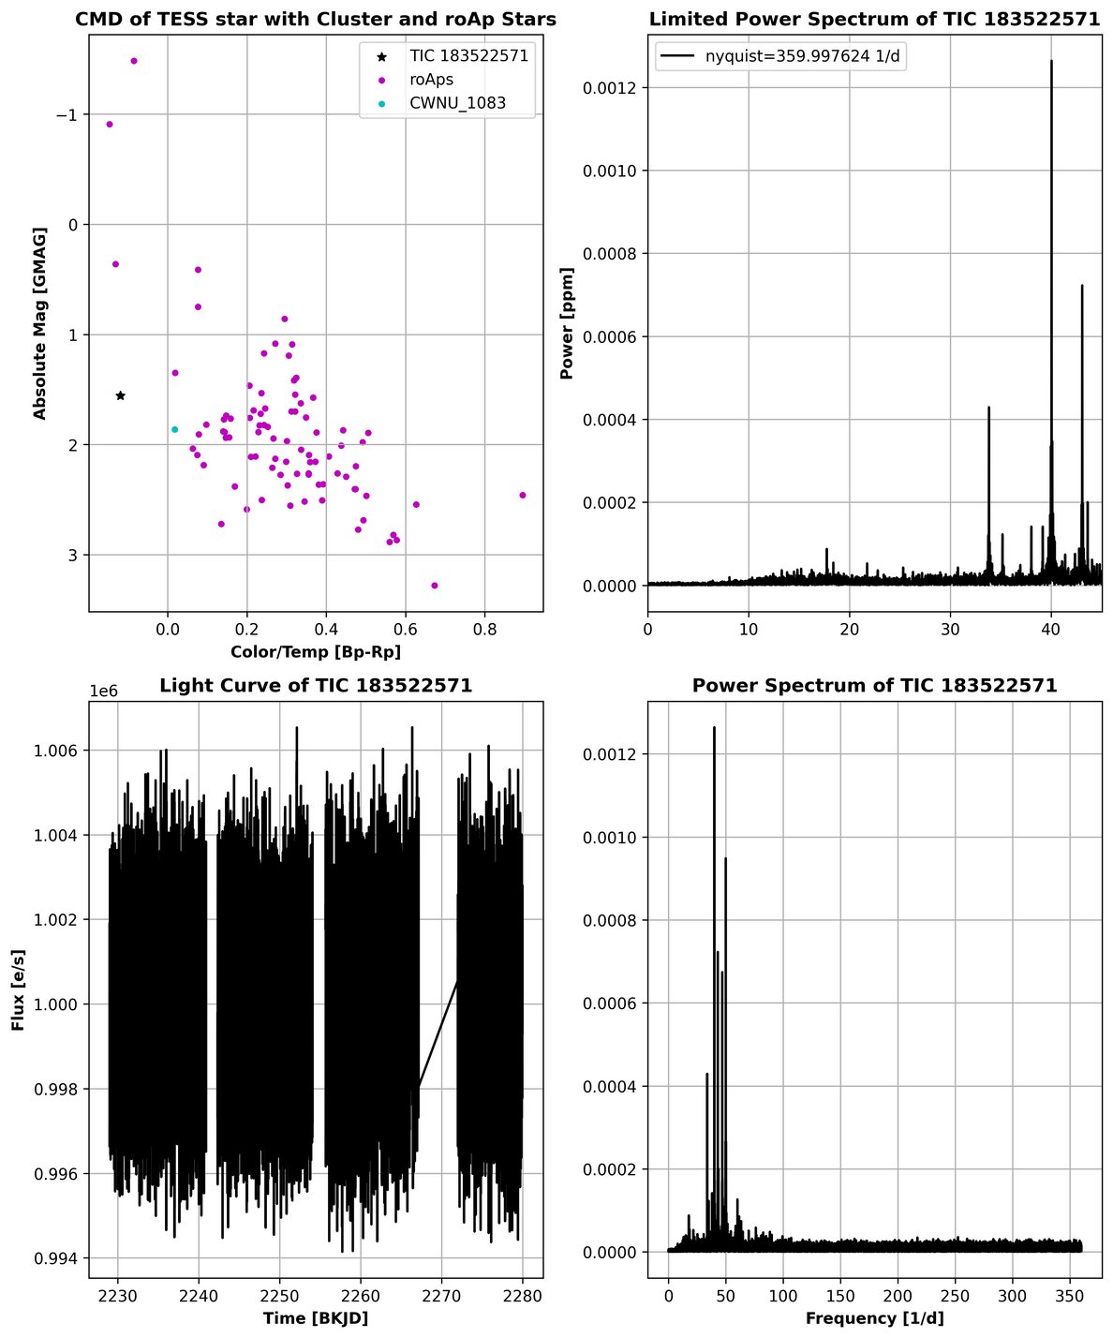
Example of really bad (left) and really good (right) candidate
TESS RESULTS
Took 2 days to de-redden 7 thousand clusters.
656 out of the 7 thousand were analyzed.
80 stars returned short cadence results from TESS lightcurve search.
Picked 20 out of the 80 which looked plausible.

Slide 7
TESS RESULTS CONT.
What makes this a good candidate?
Obvious peaks in the power spectrum.
Decent light curve.
Placement on CMD.
Simbad says it is a young stellar object with spectral type A1.
Not a BSS, could be another pulsator? No papers on it, will look into it.

Slide 8
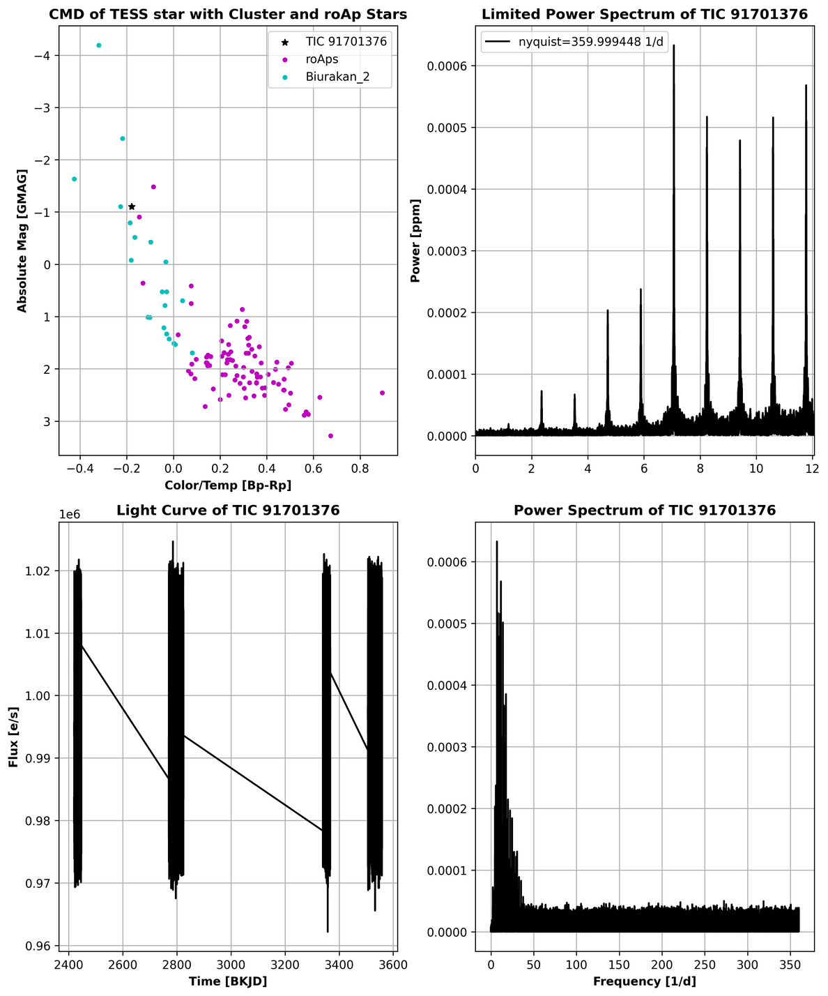
TESS RESULTS CONT.
What makes this a good candidate?
Obvious peaks in the power spectrum.
Placement on CMD.
Simbad says it is a pulsating variable object with spectral type B0.
Could very well be a BSS! No papers on it.
Need to get the rotational period and velocities to further determine.

Slide 9
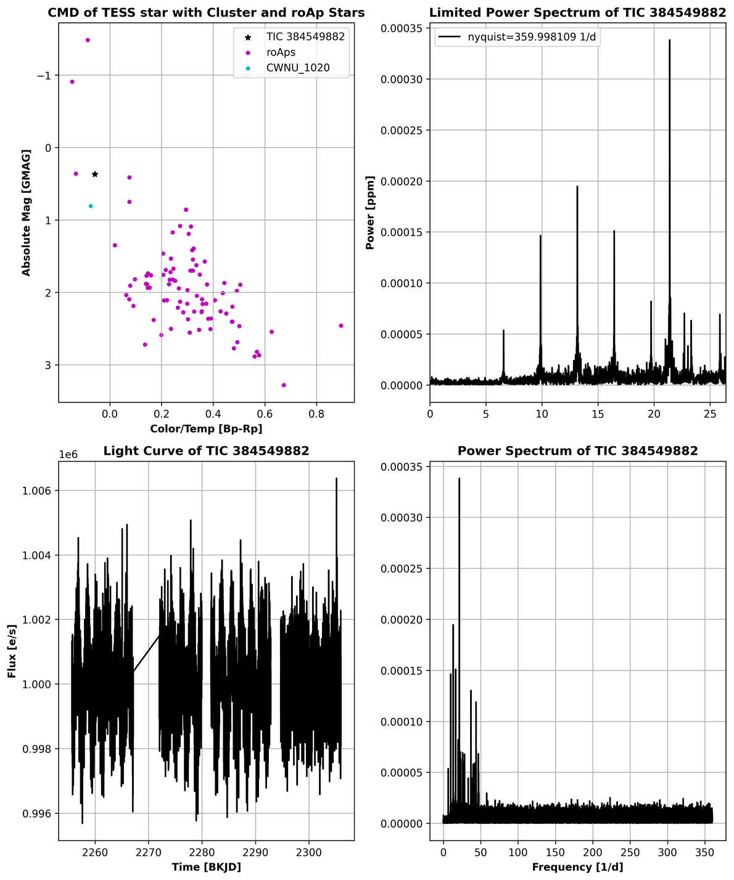
TESS RESULTS CONT.
What makes this a good candidate?
Obvious peaks in the power spectrum.
Good light curve.
Placement on CMD.
Simbad says it has spectral type B9.5V.
Could very well be a BSS! No papers on it.
Need to get the rotational period and velocities to further determine.

Slide 10
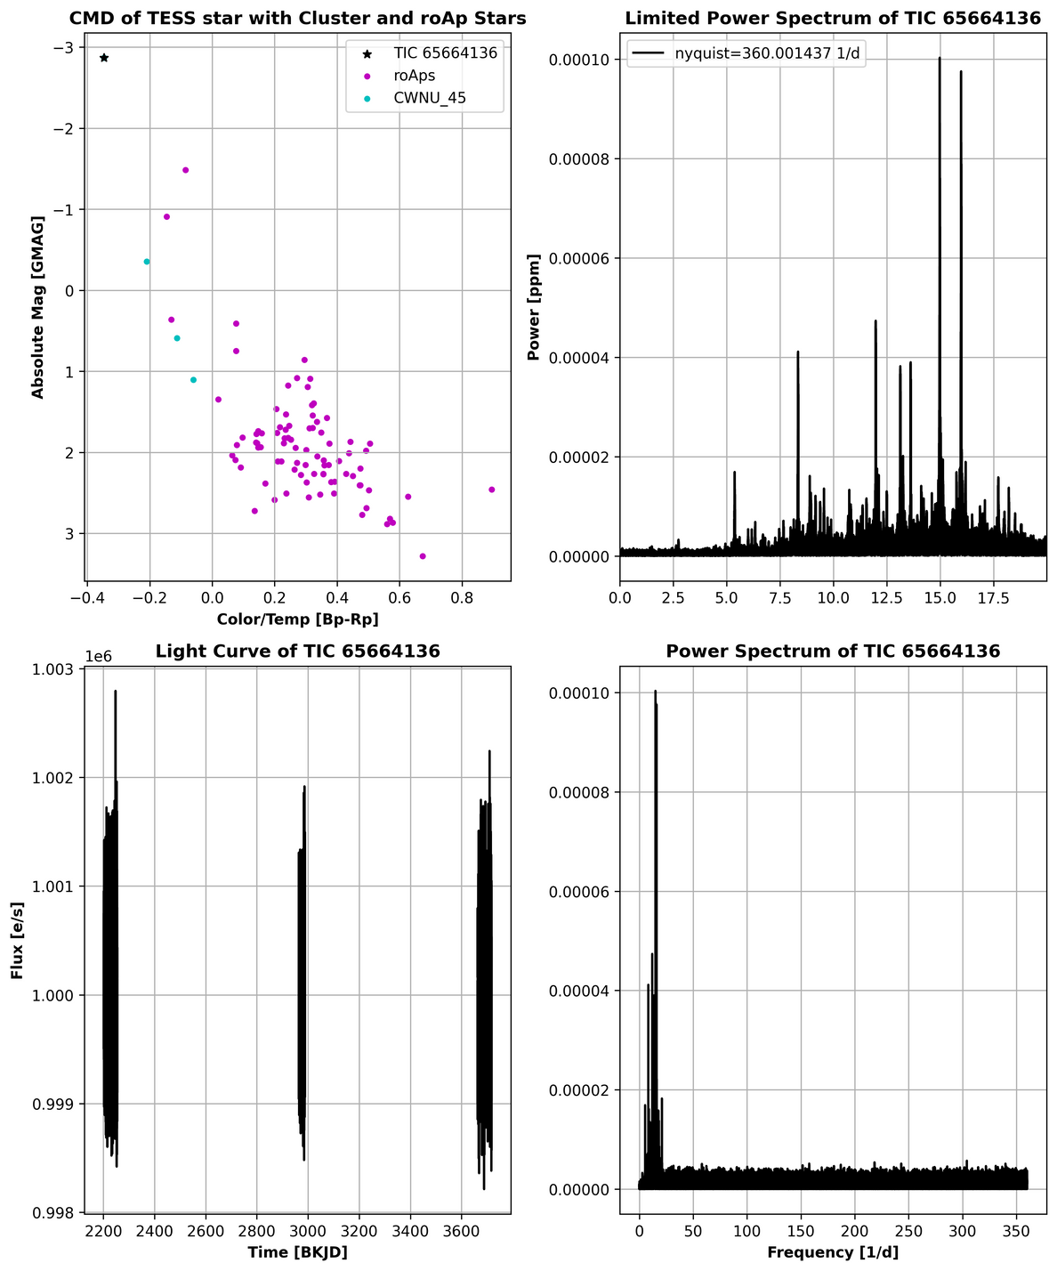
TESS RESULTS CONT.
What makes this a good candidate?
Obvious peaks in the power spectrum.
Simbad says it is a pulsating variable with spectral type B2II.
Could very well be a BSS! No papers on it pertaining to variability.
Need to get the rotational period and velocities to further determine.

Slide 11
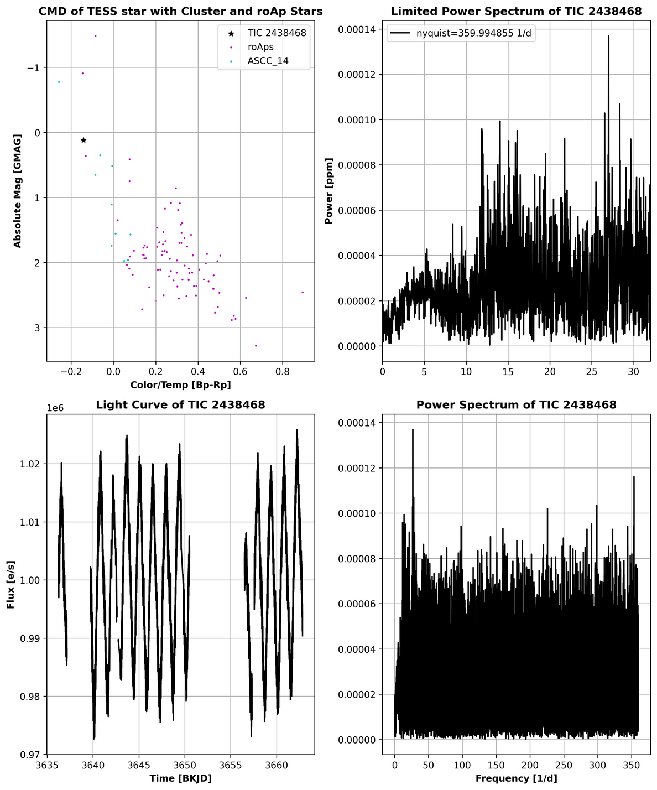
TESS RESULTS CONT.
What makes this a good candidate?
Decent peaks in the power spectrum.
Good light curve.
Good CMD placement.
Simbad says it is chemically peculiar with spectral type B5IV-V.
Could very well be a BSS! No papers on it pertaining to variability.
Need to get the rotational period and velocities to further determine.

Slide 12
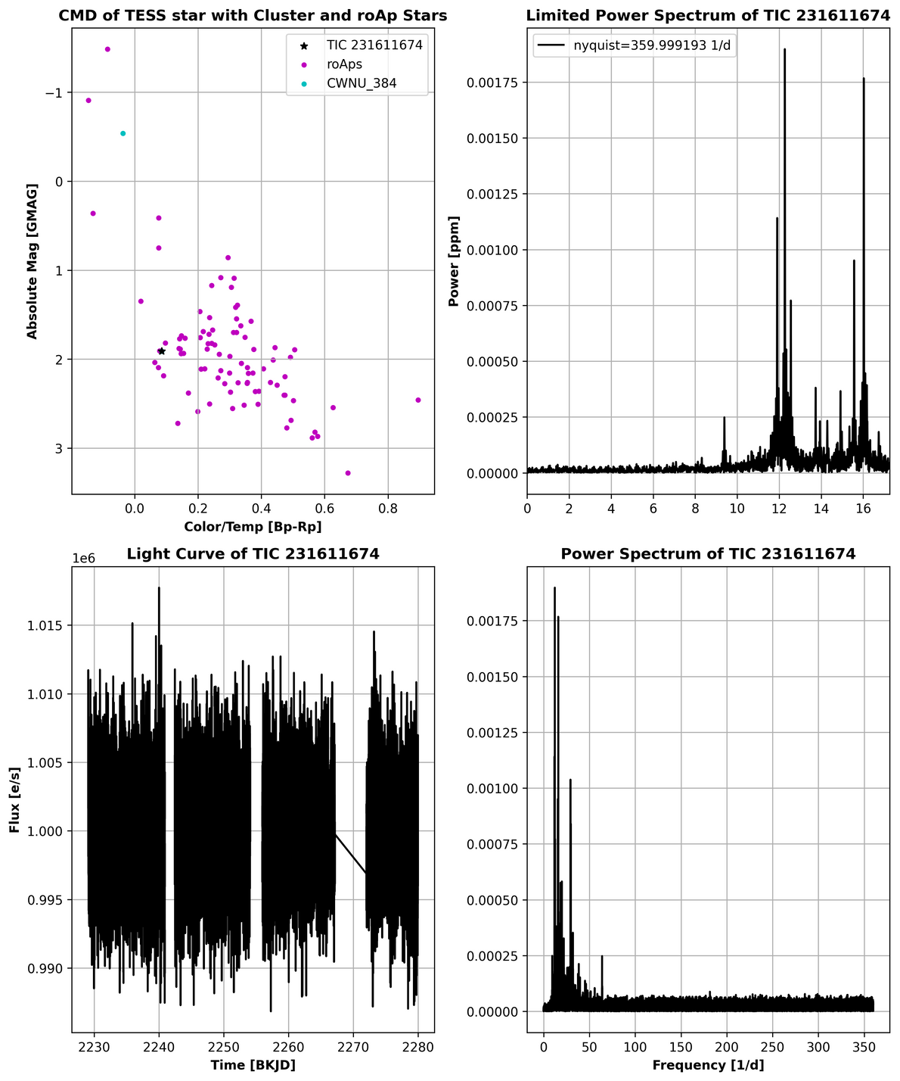
TESS RESULTS CONT.
What makes this a good candidate?
Obvious peaks in the power spectrum.
Good light curve.
Good placement on CMD.
Simbad says it is a spectroscopic binary with no spectral type, but has B-mag of 11.6.
Could possibly be a BSS as it is a binary, need to look further into it.

Slide 13
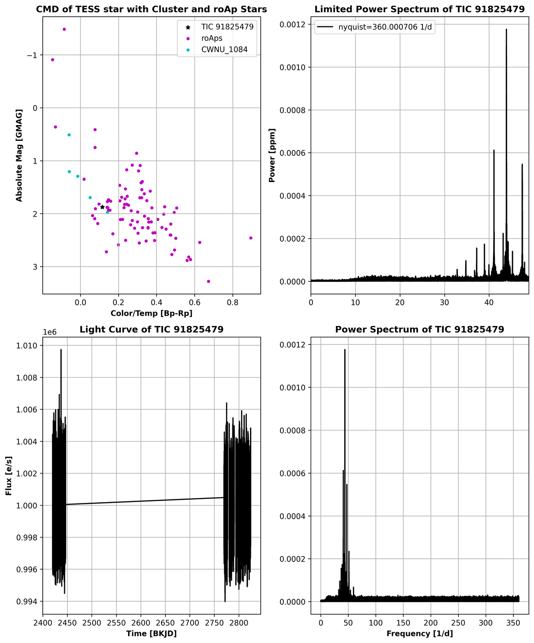
TESS RESULTS CONT.
What makes this a good candidate?
Obvious peaks in the power spectrum.
Simbad says it has spectral type A3
Not a BSS due to placement, but is a delta scuti. Found paper on it classifying it as such.

Slide 14
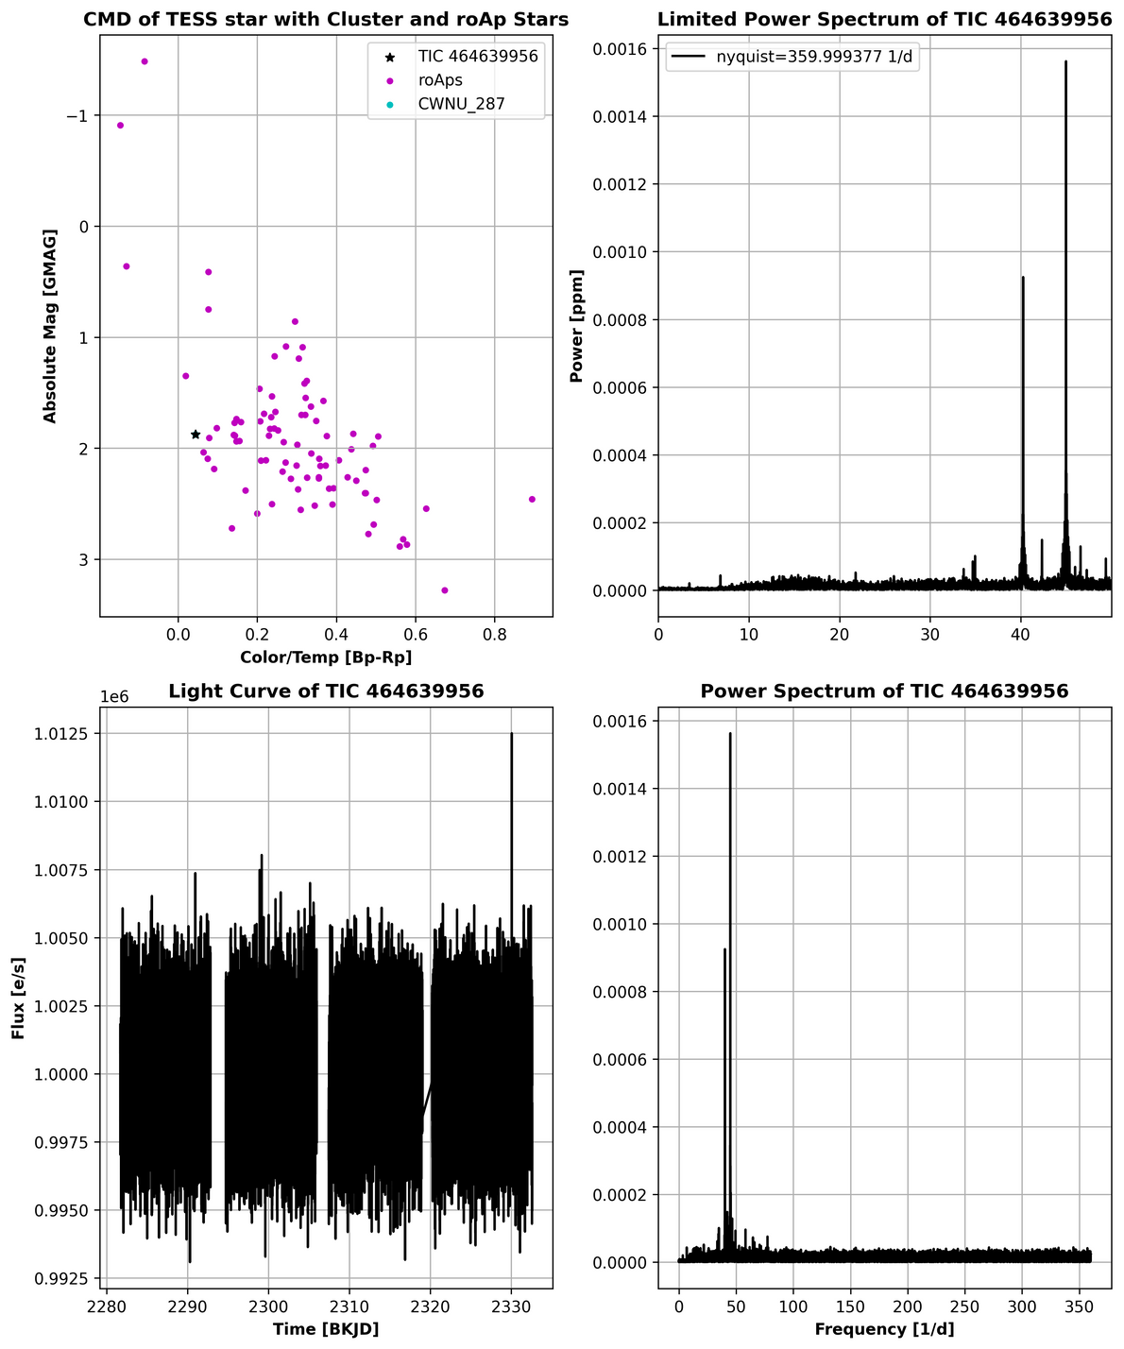
TESS RESULTS CONT.
What makes this a good candidate?
Obvious peaks in the power spectrum.
Simbad says it has spectral type A2.
Not a BSS due to placement, but could be an roAp or delta scuti, Found paper on it.

Slide 15
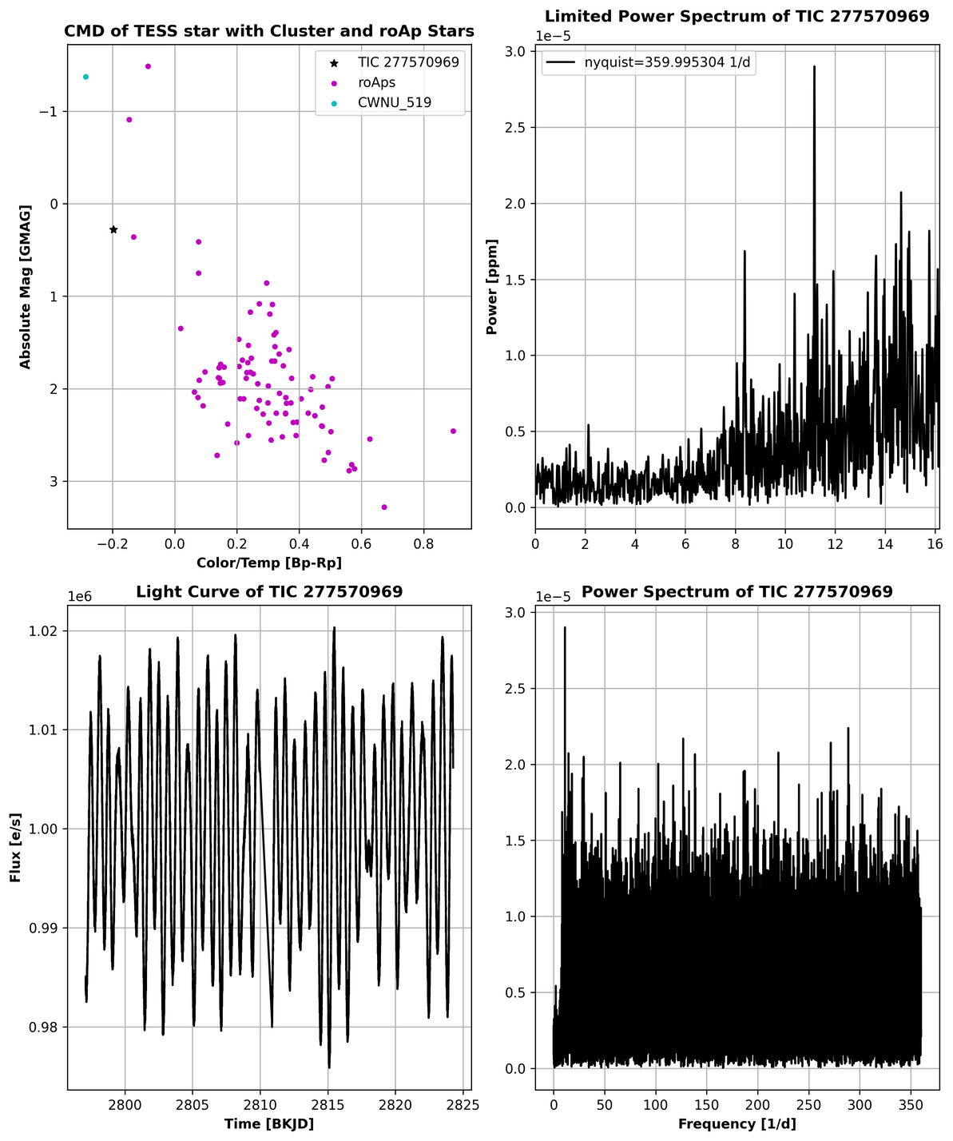
TESS RESULTS CONT.
What makes this a good candidate?
Some peaks in the power spectrum.
Good light curve.
Good placement on CMD.
Simbad says it is a pulsating variable, spectral type A0.
Unlikely is a BSS, but will look further into it.

Slide 16
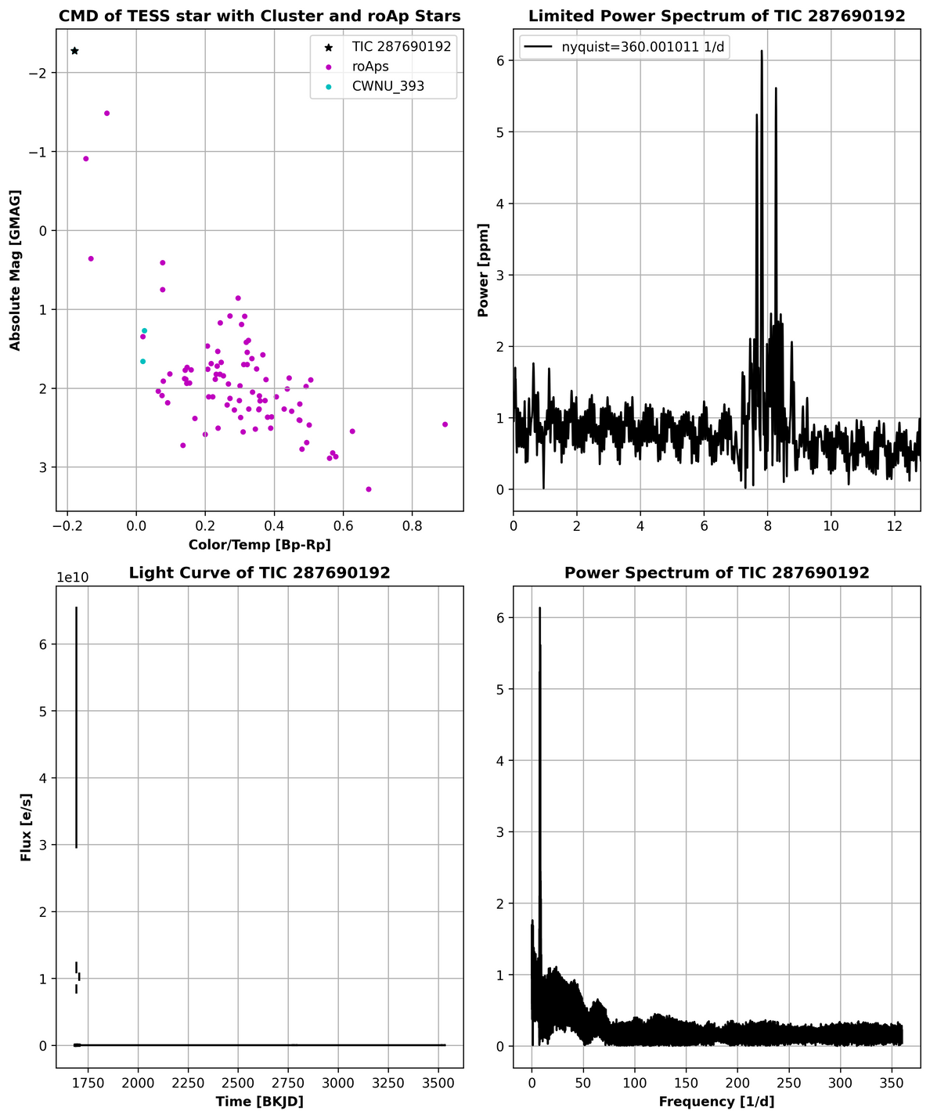
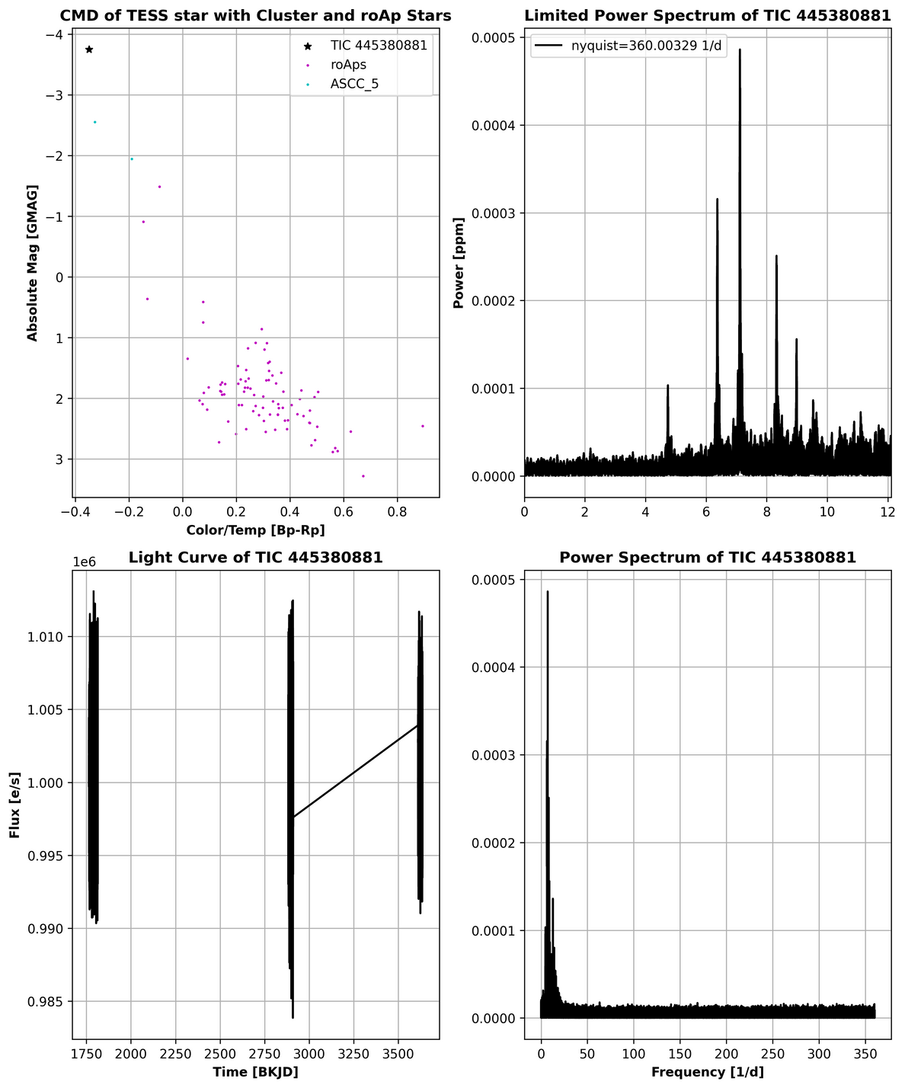
TESS RESULTS CONT.
What makes this a good candidate?
Good peaks in the Power spectrum
Bad placement on CMD, as it falls higher on the MS than a BSS would.
Simbad says these are both beta Cephai variables!

Slide 17
ALL FINAL RESULTS
TargetID | Nyquist Frequency | Max Power | Frequency at max Power | GMAG | BP_RP
TIC 2438468 | 359.994855 | 0.000137 | 27.0048 | 0.120687 | -0.141911
TIC 91701376 | 359.999448 | 0.000633 | 7.0657 | -1.103258 | -0.178568
TIC 65664136 | 360.001437 | 0.0001 | 14.9758 | -2.87032 | -0.346843
TIC 231611674 | 359.999193 | 0.001898 | 12.2675 | 1.909087 | 0.085605
TIC 277570969 | 359.995304 | 2.9e-05 | 11.1696 | 0.281081 | -0.197081
TIC 384549882 | 359.998109 | 0.000338 | 21.3921 | 0.366899 | -0.058503
TIC 183522571 | 359.997624 | 0.001264 | 40.0451 | 1.555832 | -0.11954
TIC 91825479 | 360.000706 | 0.001176 | 43.8871 | 1.875576 | 0.115315
TIC 464639956 | 359.999377 | 0.001562 | 44.9952 | 1.877889 | 0.043814

Slide 18
understanding the results and future tests
Are the stars showing signs of pulsations that differ from stars of similar mass and luminosity?
Some showed pulsations and some did not, why?
Why was some data terrible and others good?
Can the results be improved?
Is more or different data needed?
Possibly heliocentric and rotational velocities and metallicities

Slide 19

THANK YOU!
QUESTIONS?

